Slide 1

IOT BASED HOSTEL MANAGEMENT SYSTEM

Slide 2
PSN INSTITUTE OF TECHNOLOGY AND SCIENCE
Presented By
ANITHA S
ARSHINI X
GOKILA R
HARINI KUMARI J
Department : Electronics and Communication Engineering
Guide : Ms.J.Anupriya

Slide 3
Introduction:
This research aims to create and develop an automatic fan control system based on the Internet of Things (IoT) that can regulate the room temperature well. The NodeMCU ESP8266 serve as a microcontroller for this system.
We built an IoT based system which can automatically switch ON room lights and fan when at least one person is present in the room. If room is empty, the lights and fan will automatically get switch off. It also displays count of persons present in the room.
This research aims to create and develop an automatic fan control system based on the Internet of Things (IoT) that can regulate the room temperature well. The Node MCU ESP8266 serve as a microcontroller for this system.

Slide 4


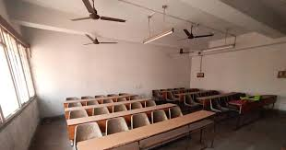
Existing System Challenges:
Manual attendance system leads to time consumption and errors.
Students may forget to sign attendance register.
No proper tracking of student entry and exit in hostel rooms.
Energy wastage occurs when lights and fans are left ON in empty rooms.
Lack of automation reduces efficiency in hostel management

Slide 5
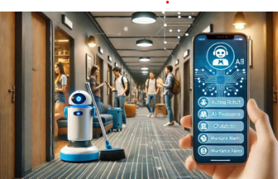
Smart solution design:
Uses IoT for smart hostel management
RFID tracks student entry and exit
Arduino processes system data
PIR sensor monitors room activity
Data sent to database via Wi-Fi
Enables real-time monitoring
Sends alerts for unauthorized access
Maintains secure and accurate records

Slide 6
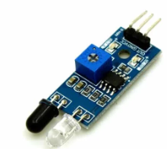
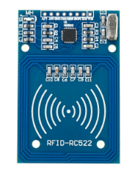
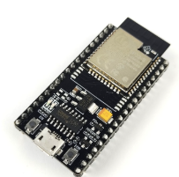
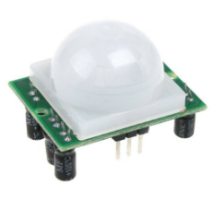
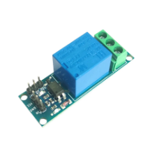
Components required
IR Sensor
ESP 32
RF ID Reader
PIR Sensor
Relay Module

Slide 7
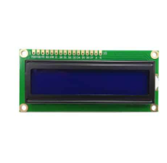
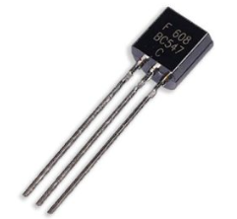
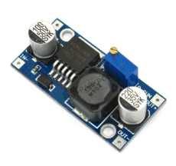
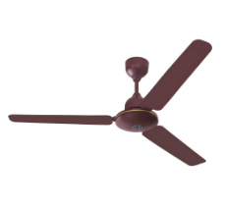

LCD Display
Transistor BC547
Bug Converter
Fan
Light

Slide 8
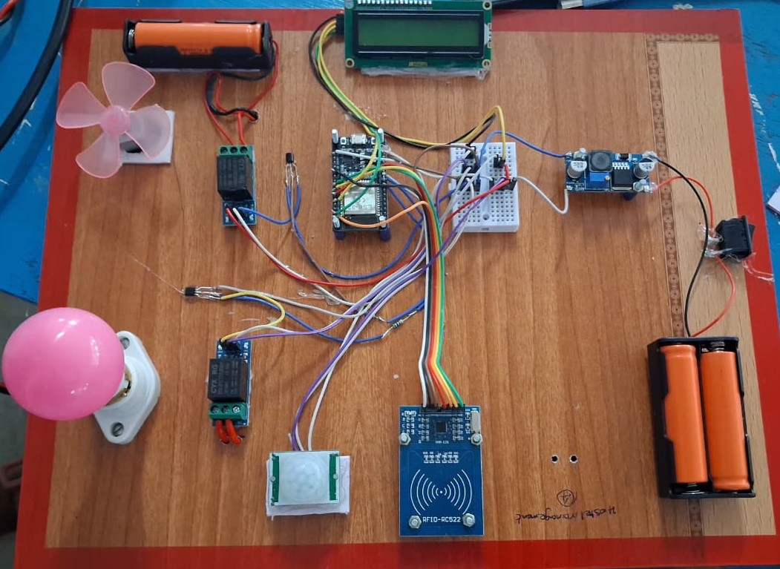
PROJECT OUTPUT

Slide 9
WORKING PRINCIPLE
The system uses RFID to identify students and record their entry and exit. A PIR sensor detects room occupancy, and the ESP32 processes this data to control appliances automatically. All information is sent to a cloud server via Wifi , allowing the hostel administrator to monitor rooms and student activity in real time.

Slide 10

Advantages
Reduces manual work
Improves hostel security
Saves time and effort
Enables real-time monitoring
Minimizes human errors
Energy efficient system
Easy to manage large number of students

Slide 11

DISADVANTAGES
High Initial Cost
Dependence on Internet
Maintenance Required
Power Dependency
Accuracy Issues

Slide 12

Application
Applications include hostels, colleges, smart homes, offices, hotels, hospitals, and energy management systems where automation, security, and real-time monitoring are required.

Slide 13

CONCLUSTION
This system significantly reduces manual effort, improves security, and ensures optimal energy utilization by automatically controlling electrical devices based on real-time room usage.

Slide 14

FUTURE SCOPE
Improved Network Technologies
Scalability to Smart Campus
Smart Environment Control
Mobile App Development

Slide 15
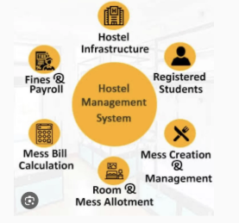
System overview
ESP32-based smart hostel system
Uses RFID for student identification
PIR sensor for occupancy detection
Automatic control of lights and fan
Data sent to cloud via WiFi
Enables real-time remote monitoring

Slide 16
Thank You!...

